Slide 1
PDAs Accept
Context-Free Languages

Slide 2

Theorem:
Context-Free
Languages
(Grammars)
Languages
Accepted by
PDAs

Slide 3
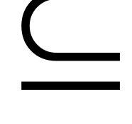



Proof - Step 1:
Context-Free
Languages
(Grammars)
Languages
Accepted by
PDAs
Convert any context-free grammar
to a PDA with:

Slide 4

Proof - Step 2:
Context-Free
Languages
(Grammars)
Languages
Accepted by
PDAs
Convert any PDA to a context-free
grammar with:

Slide 5
Converting
Context-Free Grammars to
PDAs
Proof - step 1

Slide 6
Context-Free
Languages
(Grammars)
Languages
Accepted by
PDAs
Convert any context-free grammar
to a PDA with:

Slide 7


We will convert grammar
to a PDA such that:
simulates leftmost derivations of

Slide 8



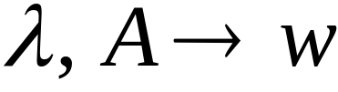
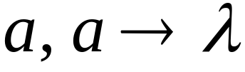
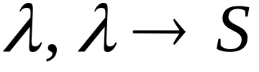




Convert grammar to PDA
Production in
Terminal in

Slide 9
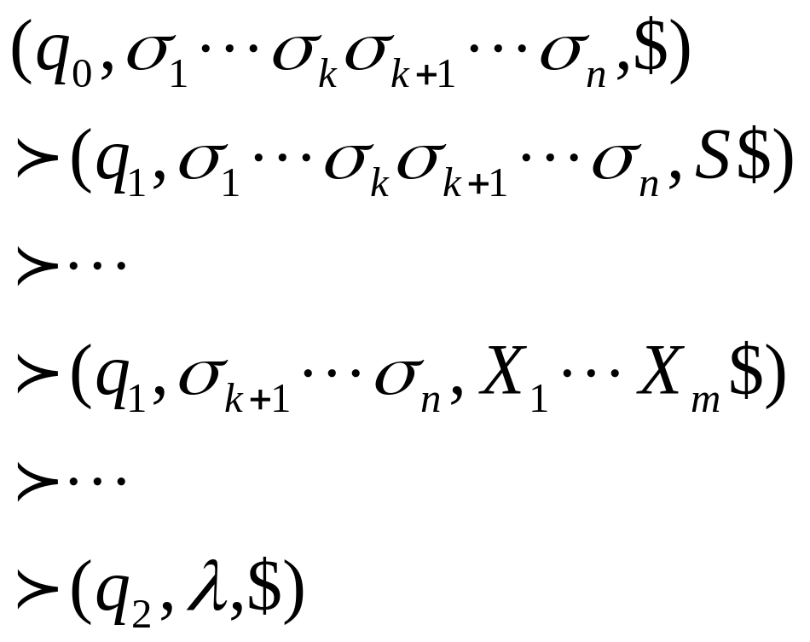
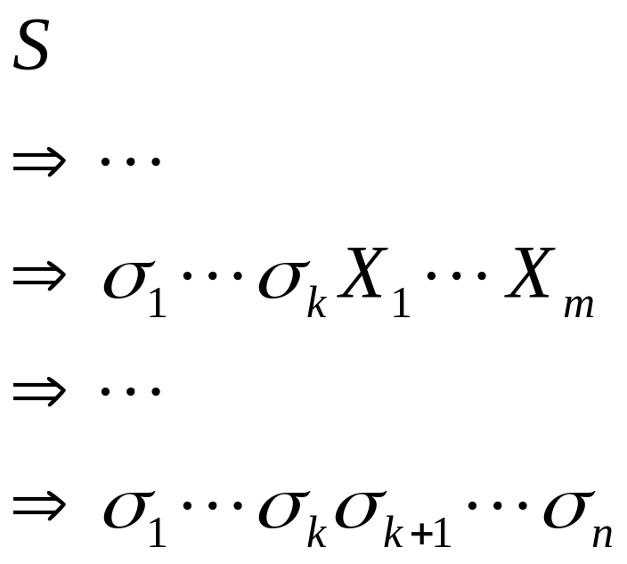
Grammar
leftmost
derivation
PDA computation
Simulates grammar
leftmost derivations
Leftmost
variable

Slide 10
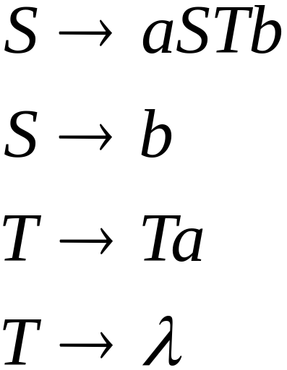
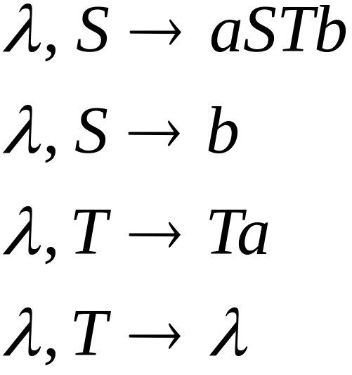
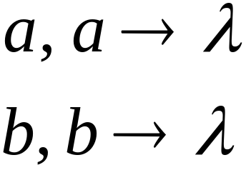
Example
Grammar
PDA

Slide 11
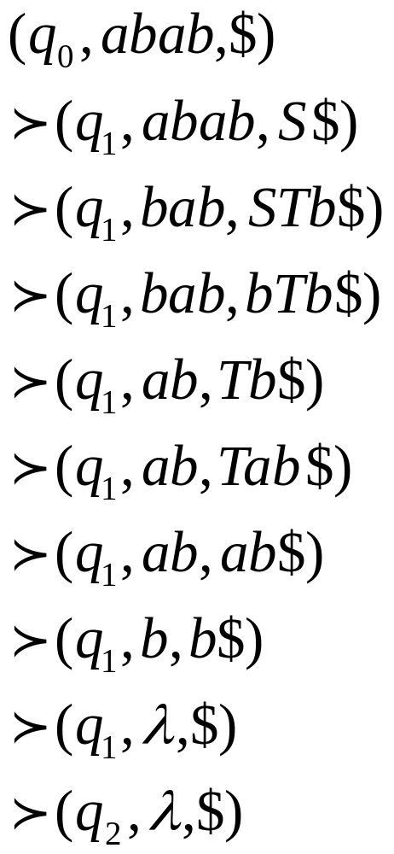
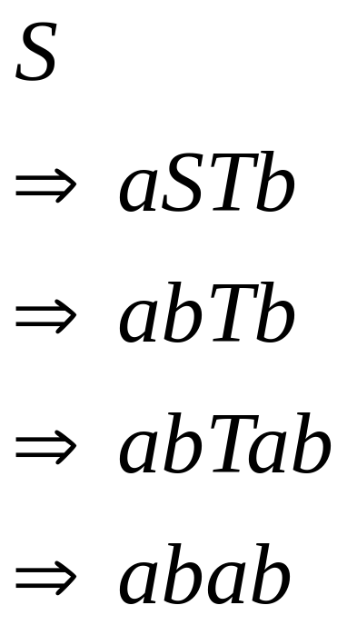
Grammar
derivation
PDA computation

Slide 12




Derivation:
Input
Time 0
Stack

Slide 13


Derivation:
Input
Time 0
Stack

Slide 14


Derivation:
Input
Time 1
Stack

Slide 15
Derivation:
Input
Time 2
Stack

Slide 16

Derivation:
Input
Time 3
Stack

Slide 17
Derivation:
Input
Time 4
Stack

Slide 18
Derivation:
Input
Time 5
Stack

Slide 19
Derivation:
Input
Time 6
Stack

Slide 20
Derivation:
Input
Time 7
Stack

Slide 21
Derivation:
Input
Time 8
Stack

Slide 22
Derivation:
Input
Time 9
Stack
accept

Slide 23

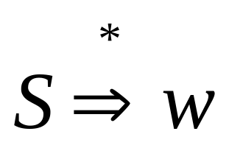
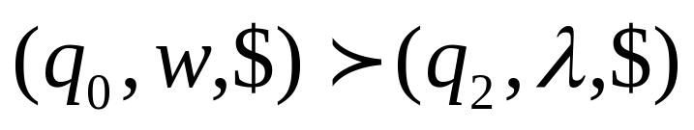
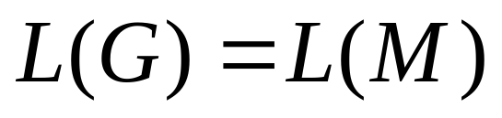
In general, it can be shown that:
Grammar
generates
string
If and
Only if
PDA
accepts
Therefore

Slide 24

Therefore:
For any context-free language
there is a PDA that accepts
Context-Free
Languages
(Grammars)
Languages
Accepted by
PDAs

Slide 25
Converting
PDAs to
Context-Free Grammars
Proof - step 2

Slide 26
Context-Free
Languages
(Grammars)
Languages
Accepted by
PDAs
Convert any PDA to a context-free
grammar with:

Slide 27
We can convert PDA to
a context-free grammar such that:
simulates computations of
with leftmost derivations

Slide 28


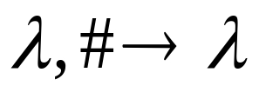
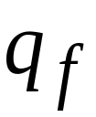
Modify the PDA so that at end
it empties stack and
has a unique accept state
Empty stack
PDA
λ
,
λ
→
λ
λ
,
λ
→
λ
→
λ
λ
,
λ
New
accept
state
Old accept states

Slide 29
Deterministic PDAs - DPDAs

Slide 30
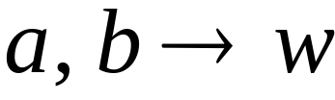

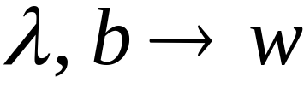

Deterministic PDA: DPDA
Allowed transitions:
(deterministic choices)

Slide 31
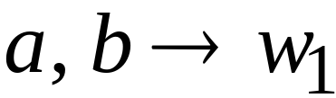
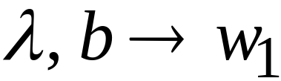
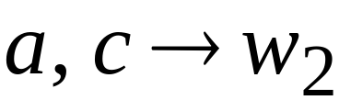
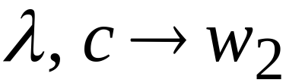

Allowed transitions:
(deterministic choices)

Slide 32
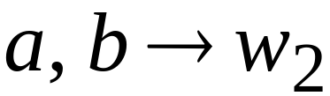
Not allowed:
(non deterministic choices)

Slide 33
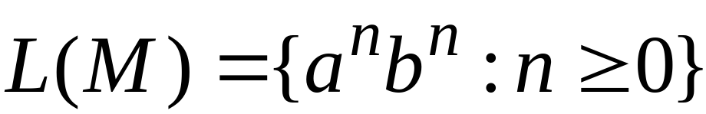


DPDA example

Slide 34

Definition:
A language is deterministic context-free
if there exists some DPDA that accepts it
Example:
The language
is deterministic context-free

Slide 35
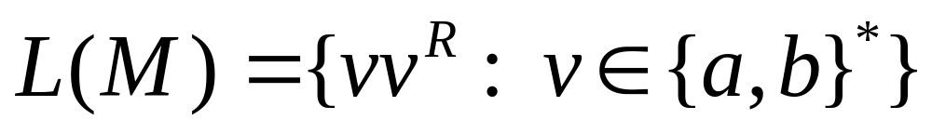
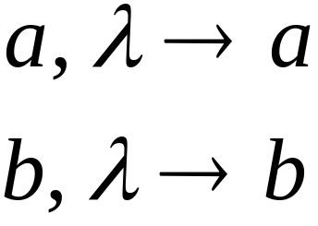


Example of Non-DPDA (PDA)

Slide 36
Not allowed in DPDAs

Slide 37
PDAs
Have More Power than
DPDAs

Slide 38
It holds that:
Deterministic
Context-Free
Languages
(DPDA)
Context-Free
Languages
PDAs
Since every DPDA is also a PDA

Slide 39


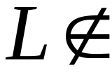
We will actually show:
Deterministic
Context-Free
Languages
(DPDA)
Context-Free
Languages
(PDA)
We will show that there exists
a context-free language which is not
accepted by any DPDA

Slide 40
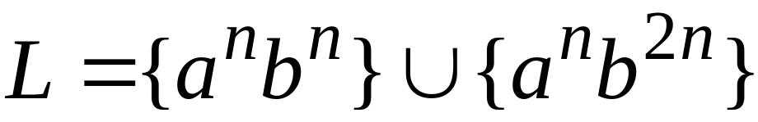

The language is:
We will show:
is context-free
is not deterministic context-free

Slide 41


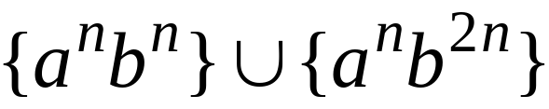
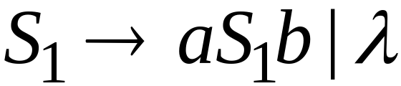
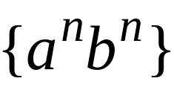
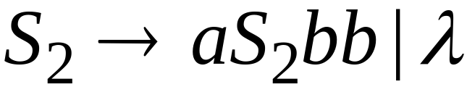
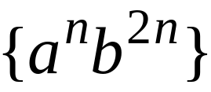
Language is context-free
Context-free grammar for :

Slide 42
Theorem:
The language
is not deterministic context-free
(there is no DPDA that accepts )

Slide 43
Proof:
Assume for contradiction that
is deterministic context free
Therefore:
there is a DPDA that accepts

Slide 44
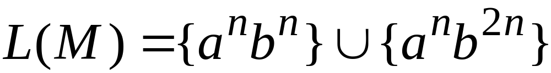
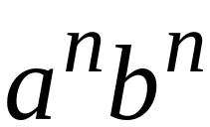
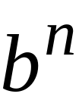
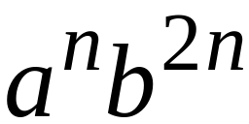
DPDA with
accepts
accepts

Slide 45
DPDA with
Such a path exists due to determinism

Slide 46
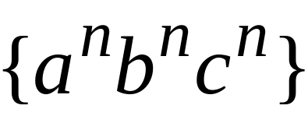


Fact 1:
The language
is not context-free
Context-free languages
Regular languages
(we will prove this at a later class using
pumping lemma for context-free languages)

Slide 47
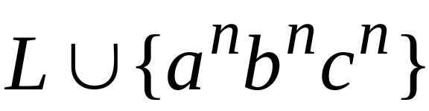
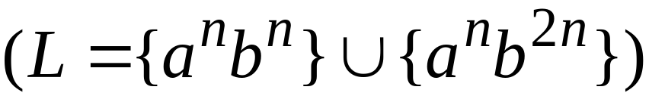
Fact 2:
The language
is not context-free
(we can prove this using pumping lemma
for context-free languages)

Slide 48
We will construct a PDA that accepts:
which is a contradiction!

Slide 49
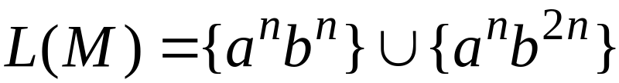



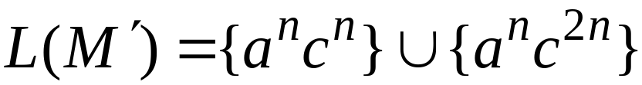
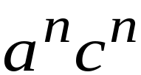

DPDA
Modify
Replace
with
DPDA

Slide 50







A PDA that accepts
Connect the final states of
with the final states of

Slide 51
Since is accepted by a PDA
it is context-free
Contradiction!
(since is not context-free)

Slide 52
Therefore:
Is not deterministic context free
There is no DPDA that accepts it
End of Proof

Slide 53
Positive Properties of
Context-Free languages

Slide 54



Union
Context-free languages
are closed under:
Union
is context free
is context free
is context-free

Slide 55
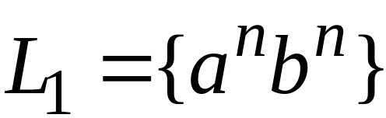
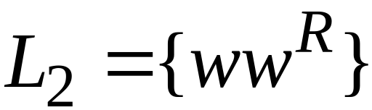
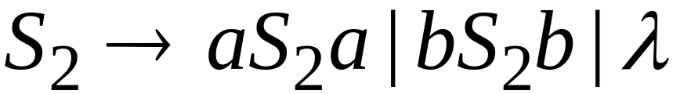
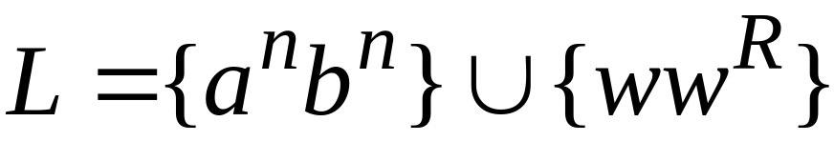
Example
Language
Grammar
Union

Slide 56
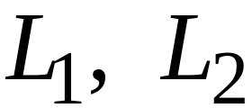
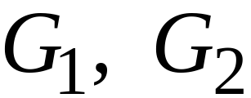
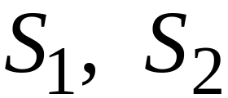

In general:
For context-free languages
with context-free grammars
and start variables
The grammar of the union
has new start variable
and additional production

Slide 57

Concatenation
Context-free languages
are closed under:
Concatenation
is context free
is context free
is context-free

Slide 58


Example
Language
Grammar
Concatenation

Slide 59
In general:
For context-free languages
with context-free grammars
and start variables
The grammar of the concatenation
has new start variable
and additional production

Slide 60

Star Operation
Context-free languages
are closed under:
Star-operation
is context free
is context-free

Slide 61




Example
Language
Grammar
Star Operation

Slide 62


In general:
For context-free language
with context-free grammar
and start variable
The grammar of the star operation
has new start variable
and additional production

Slide 63
Negative Properties of
Context-Free Languages

Slide 64

Intersection
Context-free languages
are not closed under:
intersection
is context free
is context free
not necessarily
context-free

Slide 65





Example
Context-free:
Context-free:
Intersection
NOT context-free

Slide 66

Complement
Context-free languages
are not closed under:
complement
is context free
not necessarily
context-free

Slide 67

Example
Context-free:
Context-free:
Complement
NOT context-free

Slide 68
Intersection of
Context-free languages and
Regular Languages

Slide 69
The intersection of
a context-free language and
a regular language
is a context-free language
context free
regular
context-free

Slide 70


Machine
Machine
NPDA
for
DFA
for
context-free
regular
Construct a new NPDA machine
that accepts
simulates in parallel and

Slide 71






NPDA
DFA
transition
transition
NPDA
transition

Slide 72


NPDA
DFA
transition
NPDA
transition

Slide 73



NPDA
DFA
initial state
initial state
NPDA
Initial state

Slide 74

NPDA
DFA
final state
final states
NPDA
final states

Slide 75










Example:
context-free
NPDA

Slide 76




regular
DFA

Slide 77






context-free
Automaton for:
NPDA

Slide 78


In General:
simulates in parallel and
accepts string
if and only if
accepts string and
accepts string

Slide 79

Therefore:
is NPDA
is context-free
is context-free

Slide 80
Applications of
Regular Closure

Slide 81
The intersection of
a context-free language and
a regular language
is a context-free language
Regular Closure
context free
regular
context-free

Slide 82

An Application of Regular Closure
Prove that:
is context-free

Slide 83

We know:
is context-free

Slide 84


We also know:
is regular
is regular

Slide 85


context-free
regular
(regular closure)
context-free
is context-free

Slide 86

Another Application of Regular Closure
Prove that:
is not context-free

Slide 87

If
is context-free
(regular closure)
Then
context-free
regular
context-free
Impossible!!!
Therefore, is not context free

Slide 88
Decidable Properties of
Context-Free Languages

Slide 89

Membership Question:
for context-free grammar
find if string
Membership Algorithms:
Parsers
Exhaustive search parser
CYK parsing algorithm

Slide 90

Empty Language Question:
for context-free grammar
find if
Algorithm:
Remove useless variables
Check if start variable is useless

Slide 91


Infinite Language Question:
for context-free grammar
find if is infinite
Algorithm:
1. Remove useless variables
2. Remove unit and productions
3. Create dependency graph for variables
4. If there is a loop in the dependency graph
then the language is infinite

Slide 92




Example:
Infinite language
Dependency graph

Slide 93


